Slide 1
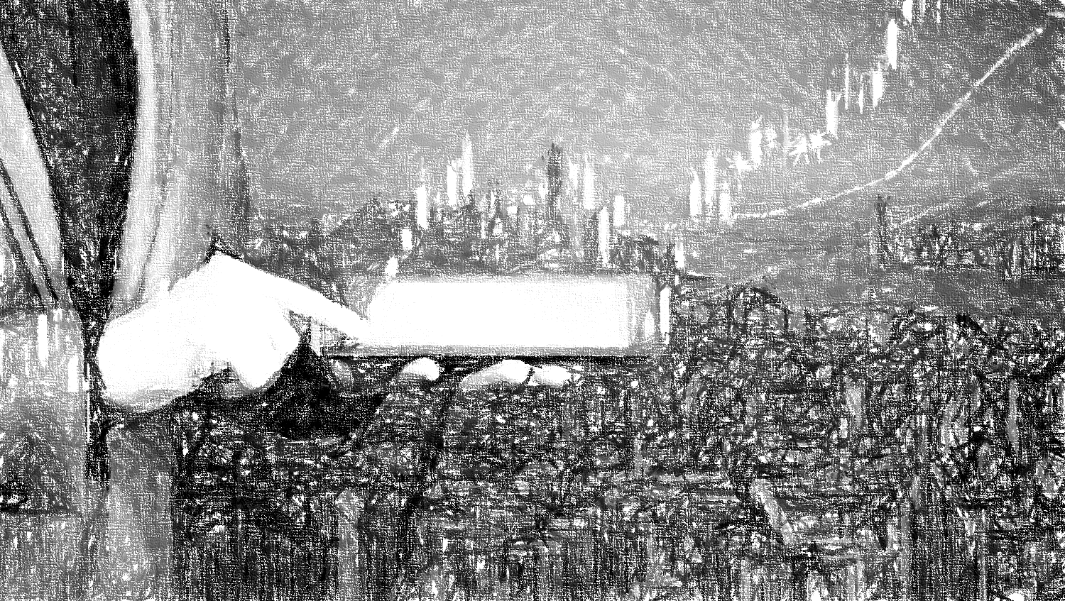
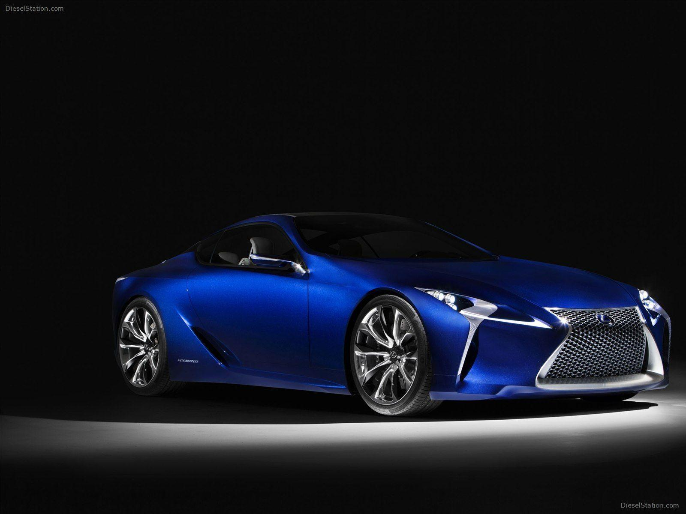
EDA on Used Cars
Ramakrishna Baba

Slide 2
Agenda
Problem
Analysis & Exploration
Recommendations & Insights
Overview
Due to the increased price of new cars, used car sales are on a global increase .
EDA methodology used on car sales data for analysis and data exploration
Global Scenario of Used car market and its sales
Overview
Problem Statement
Analysis
Exploration and Observation
Recommendation

Slide 3
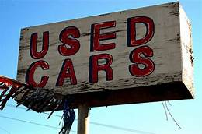
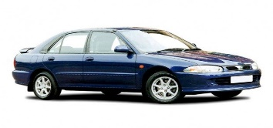
Overview
The Global Used Car Market size was estimated at USD 1332.3 billion in 2019 and is expected to reach 1402.00 billion in 2020.
Used car market is expected to grow @ a CAGR of 5.5% from 2020 to 2027 to reach USD 2150.60 billion by 2027
Asia Pacific dominated the used car market with a share of 35.6% in 2019, in terms of shipment.
Few Key players in the used car market includes Aliaba Group Holding Ltd., AutoNation Inc., eBay Inc., Maruti Suzuki India Ltd., Pendragon PLC & TrueCar Inc.,

Slide 4

Problem Statement
In the past few years, prices of new cars have skyrocketed, due to which most people are incapable of buying a new one.
Customers buying a new car always looks for value for money.
Due to the increased price of new cars, used car sales are on a global increase (Pal, Arora and Palakurthy, 2018).
There is a need for a used car price prediction system to effectively determine the worthiness of the car using a variety of features.
The company has earned its name because of sincerity in work and quality of services. But for past few months their sales is down for some reason and they are unable to figure it out.

Slide 5
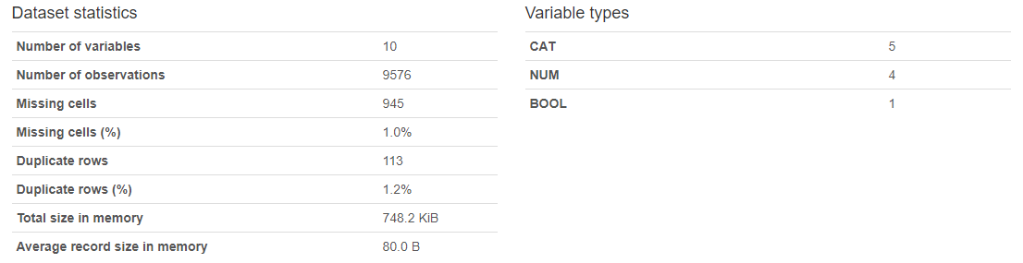
Data Analysis
We have observed engV(434) and drive(511) is missing/null values from the provided dataset. The missing or null values can’t be replace with any default value but it can be replaced with calculated values
For series of numerical values – mean, for numerical values with outliers – mode
Data Pre profiling provides a high level report of the data before it is processed further

Slide 6
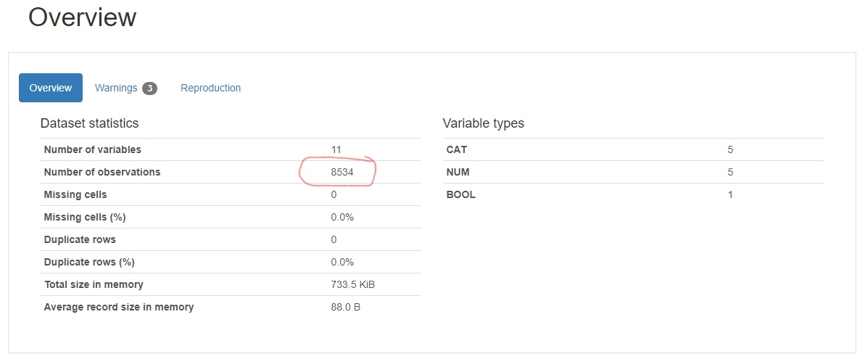
Data Analysis Contd…
To modify unstructured data to structed data we have verified and manipulated the integrity of the data by:
Handling missing data, redundant data, inconsistent data, outliers & typos
Data processed by performing data cleansing, eliminated missing values and redundant data. Post profiling report is as shown below.

Slide 7
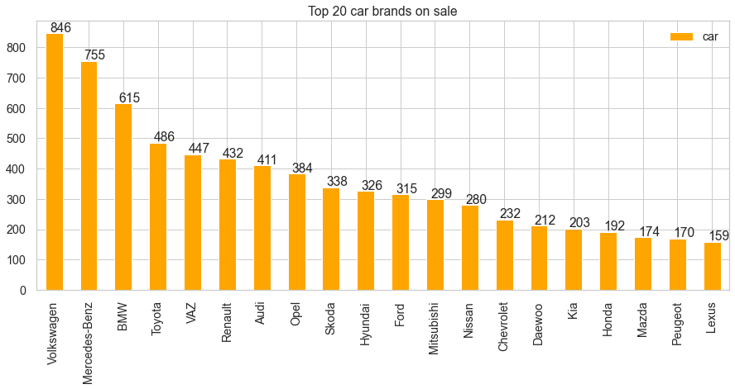
Data Exploration

Slide 8
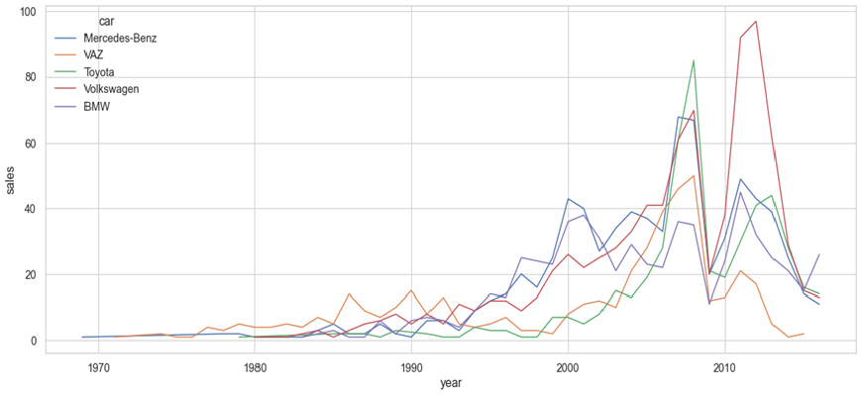
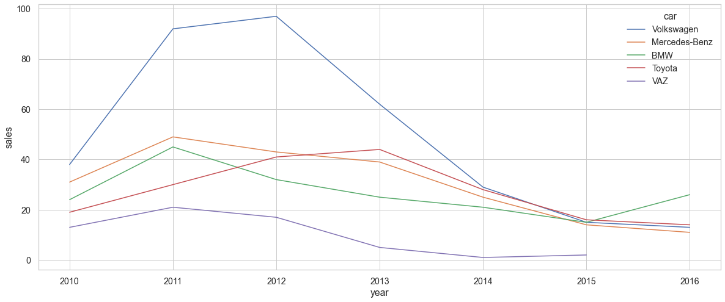
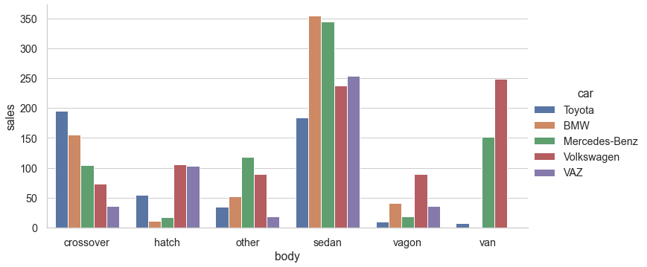
Contd…
Sales trend for top selling car manufacturers
Notes:
Observation
The above graphical representation highlights various aspects of the data.
We have derived above graph with various parameters like sales v/s year, sales v/s the make(body) and the sale v/s year post 2010.
Overall Volkswagen used car are reported high sales and occupies 1st place, but the sales are performing very low in the recent past.
Mercedes-Benz significantly performing best sales and followed by BMW. These brands sales are sky rocketed and proven the customer trust.
Toyota cars are consistent in sales and keeping their position.
On flip side, Volkswagen and Vaz car sales are under performing in recently.

Slide 9
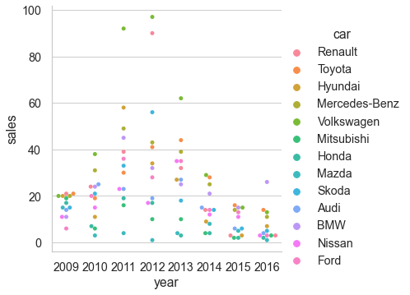
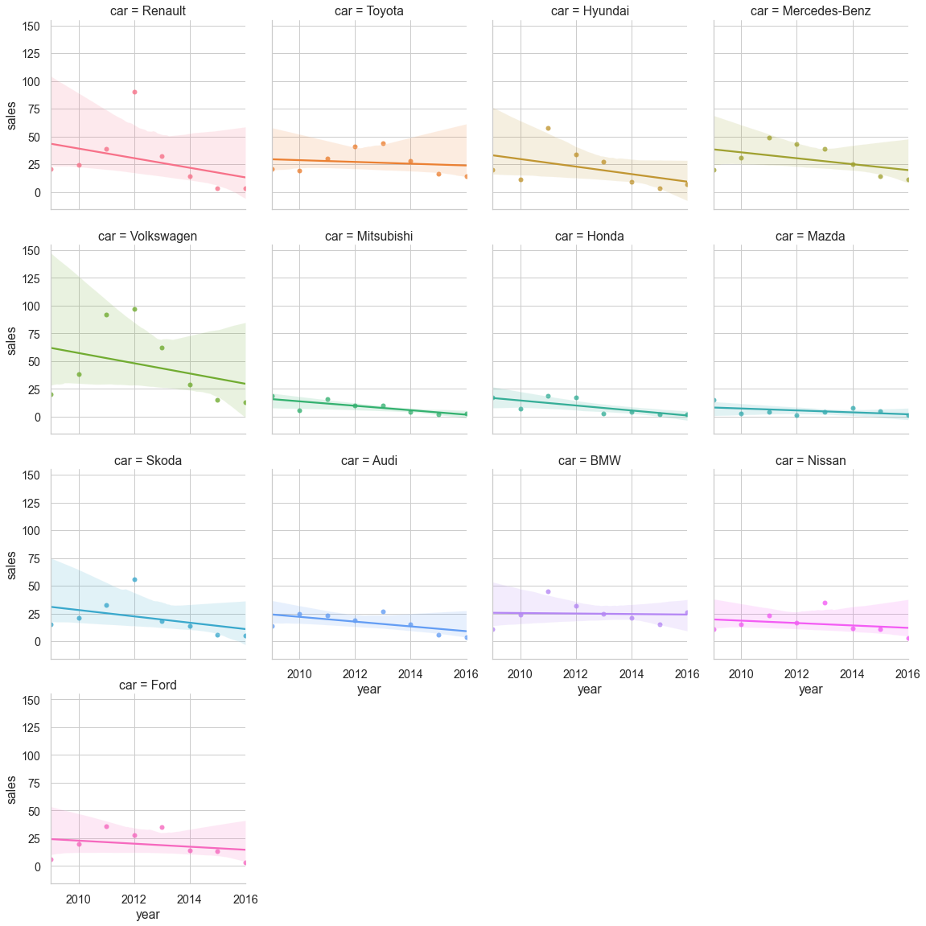
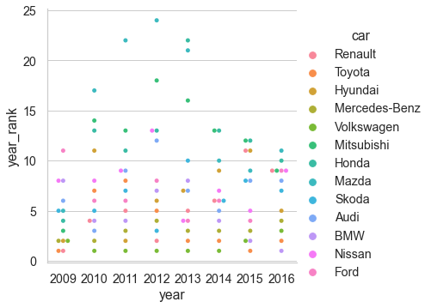
Contd…
Cars gained or lost the ground in the market
Notes:
Observation
Catplot provides access to several axes-level functions that show the relationship between a numerical and one or more categorical variables using one of several visual representations.
catplot is a wrapper for graph hbar (default) or graph bar or graph dot
Though the sales data may be high the particular year but it might not be the case with rank

Slide 10
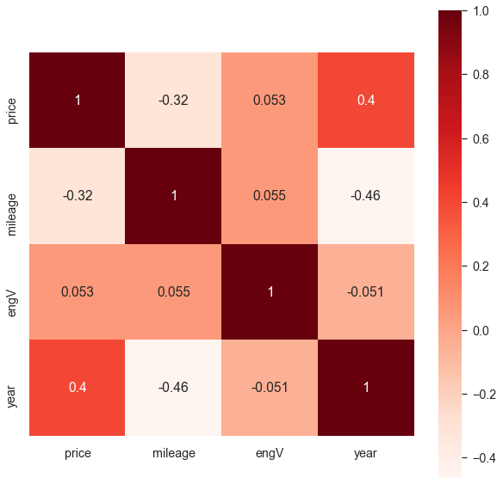
Contd…
Correlation between target parameters
Notes:
Observation
The heatmap is a way of representing the data in a 2-dimensional form.
The data values are represented as colors in the graph.
The goal of the heatmap is to provide a colored visual summary of information.
The above analysis is one of the methods used to decide which features affect the target variable the most, and in turn, get used in predicting this target variable.

Slide 11
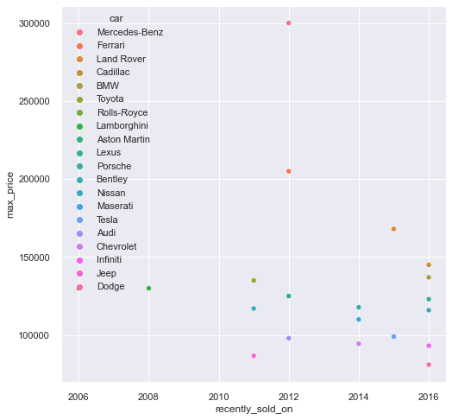
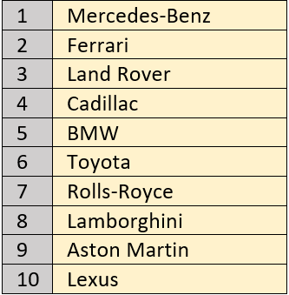
Contd…
Sales of top 10 Premium cars & models
Notes:
Observation
Top 10 premium car's sales reported as follows.
Bentley
Mulsanne
Bentayga
Flying Spur
Land Rover
Range Rover
Sales of these cars gives interesting result.
Though Mercedes-Benz and Land Rover are proven strength in sales under Premium sector, nevertheless Bentley dominating recently in this segment.
Following cars are reported premium car sales in recent years:
Mercedes-Benz
Ferrari
Land Rover
Cadillac
BMW
Toyota
Rolls-Royce
Lamborghini
Aston Martin
Lexus
But latest reported high priced cars sold as below.
Lamborghini - 2008
Mercedes-Benz & Ferrari - 2012
There are no such high priced cars sold from 2013 till 2015
Tremendous sales reported in 2016 for these super premium cars by Bentley, Land Rover, Toyota, Tesla, Lexus, Cardillac & BMW

Slide 12
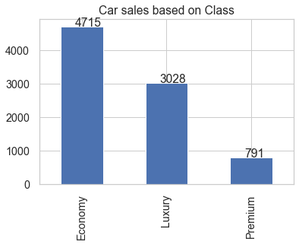
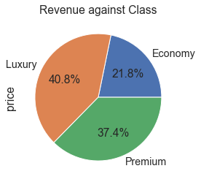
Contd…
Car segment sales & revenue
Notes:
Observation
Luxury Cars are best selling segment followed by Premium and Economy
Though the Luxury car sales are predominant in sales, but revenues are not impressive.
Economy - 21.8%
Luxury - 40.8%
Premium - 37.4%

Slide 13
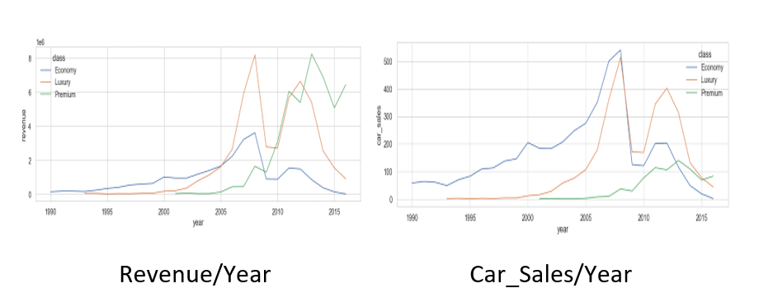
Contd…
Revenue Generated for each segment
Notes:
Observation
From the above charts, it is evident that, Economy car sales are comes to '0', Luxury and Premium takes the momentum of high sales.
In addition the revenue generated by Premium cars is exponential than other cars in recent year.
So possible reason of reduced sales due to ground touching Economy class car sales.

Slide 14
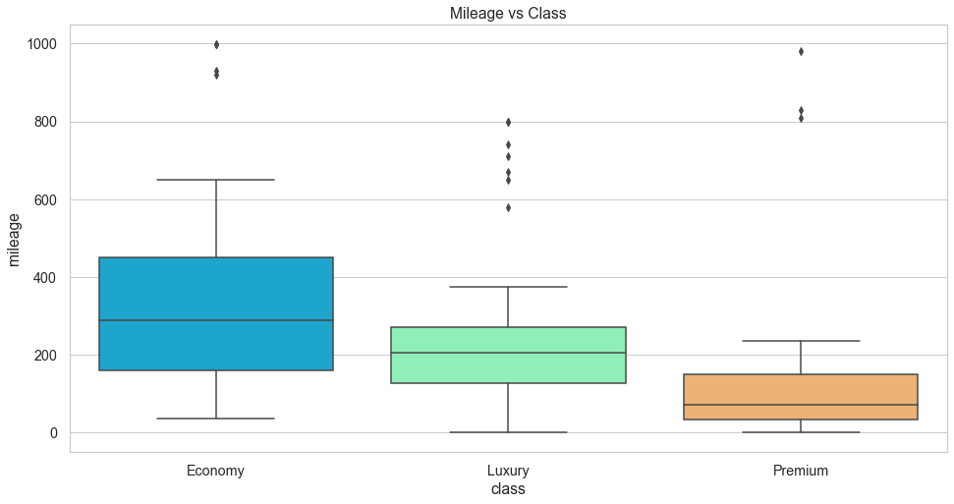
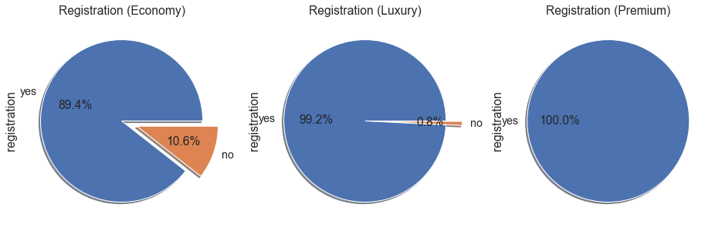
Contd…
Best mileage
Used car registrations by class
Notes:
Observation
Best Milage
Following are the best mileage given cars in each segment.
Economy --> Kia - Ceed & ZAZ - 1103
Luxury --> Volkswagen - Eos & Mercedes-Benz - S 500
Premium --> Mercedes-Benz - Sprinter 318 & GL 320
Majority of unregistered cars are from Economy class

Slide 15
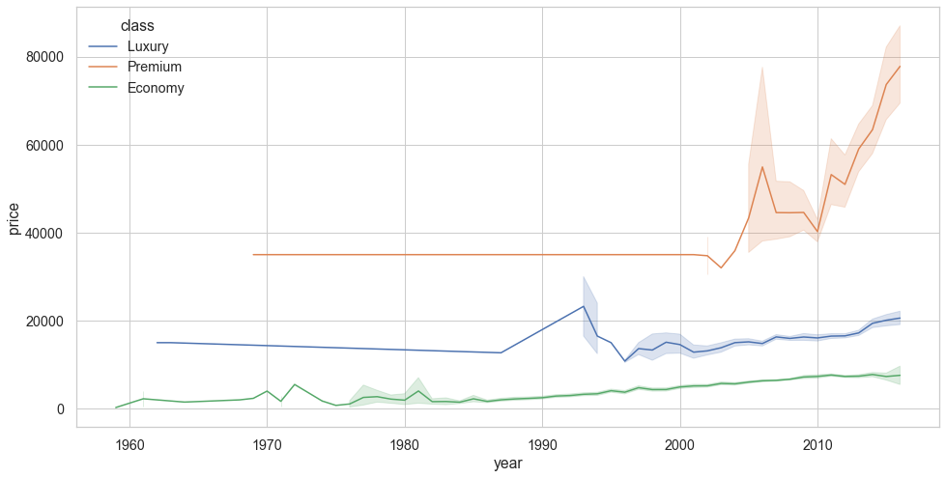
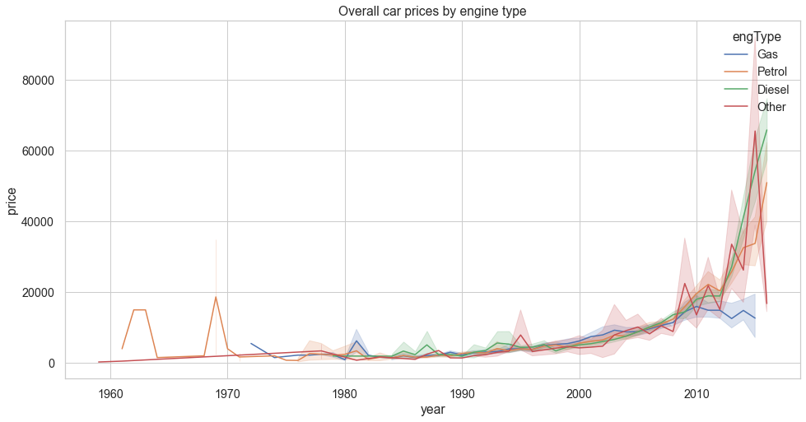
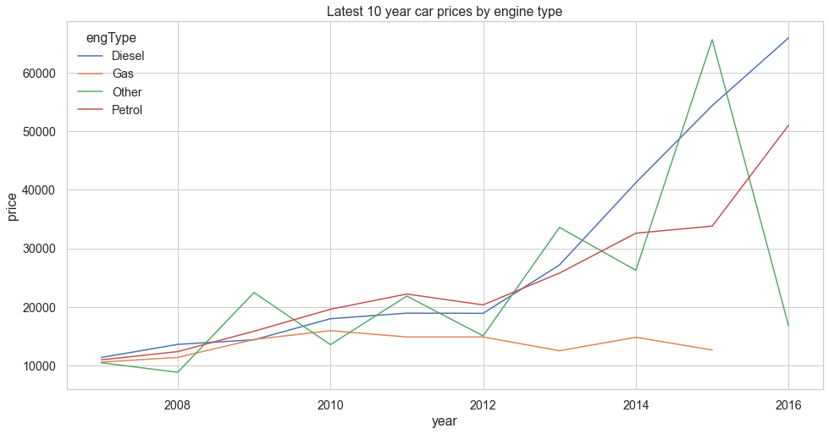
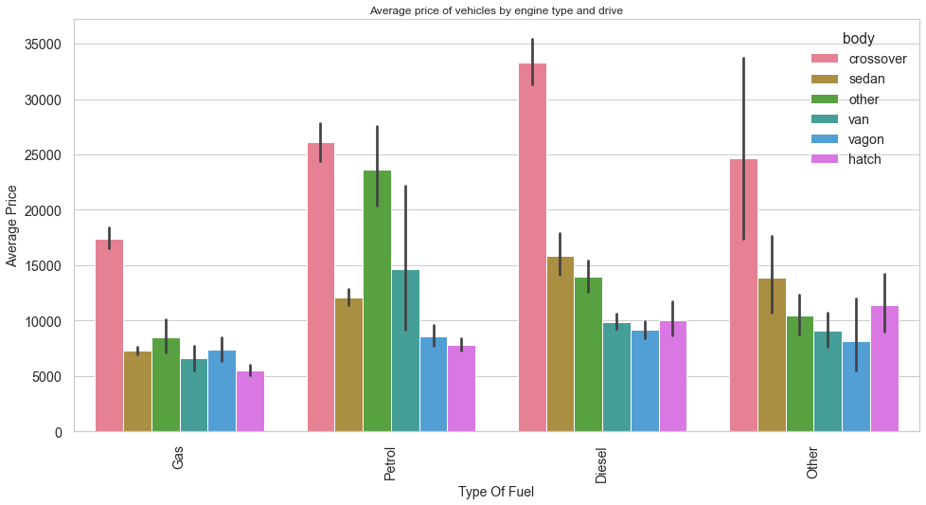
Contd…
Correlation between sales and other values
Class wise car prices
Engine Type wise car prices

Slide 16
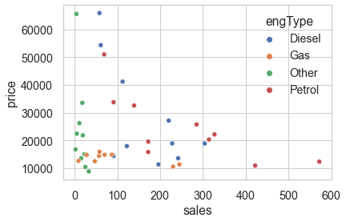
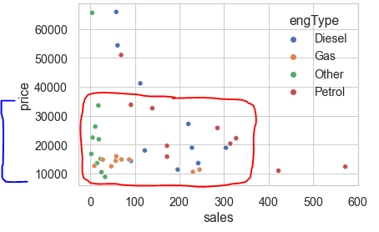
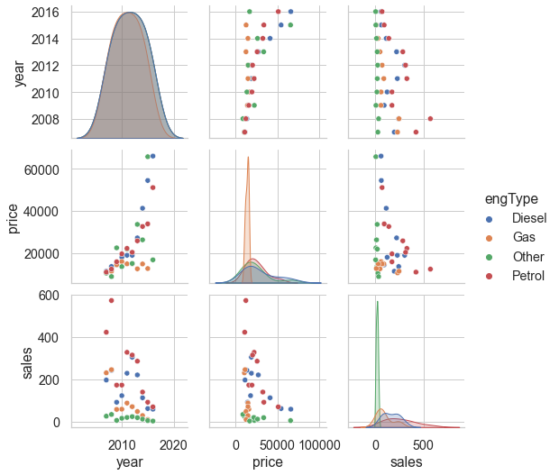
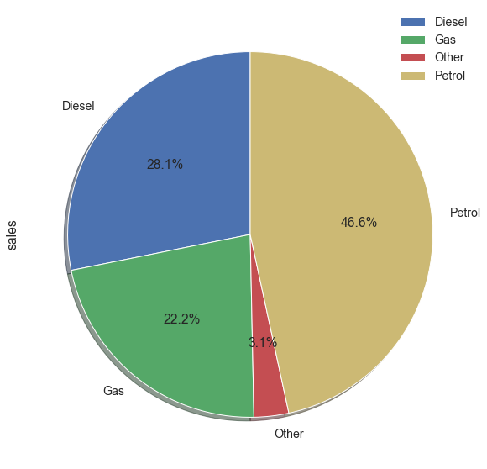
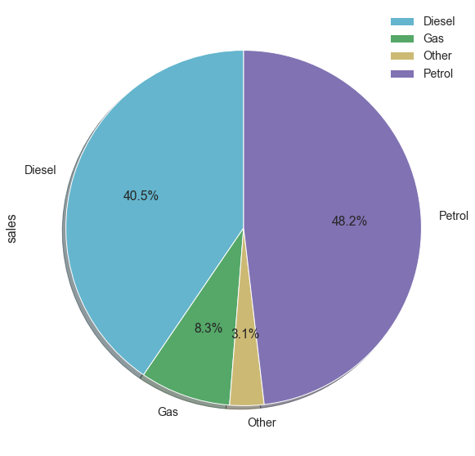
Contd…
Dataset Correlation with engine type
Sales percentage by engine type
Notes:
Observation
There are few limited cars available at 40000 to 60000 price bracket, which is high dense price range
Though the cars with Gas engine type sold at most economical price, in the recent days customers are not preferred.
Most preferred engine type is Petrol and Diesel.
Other engine type cars are gradually increasing in sales despite of its high price.
Front & Full wheel drive cars mostly opted by customers. Rear wheel drive car sales are declined drastically in last 5 years
Most sales happening price range is between 10000 to 35000 /-

Slide 17
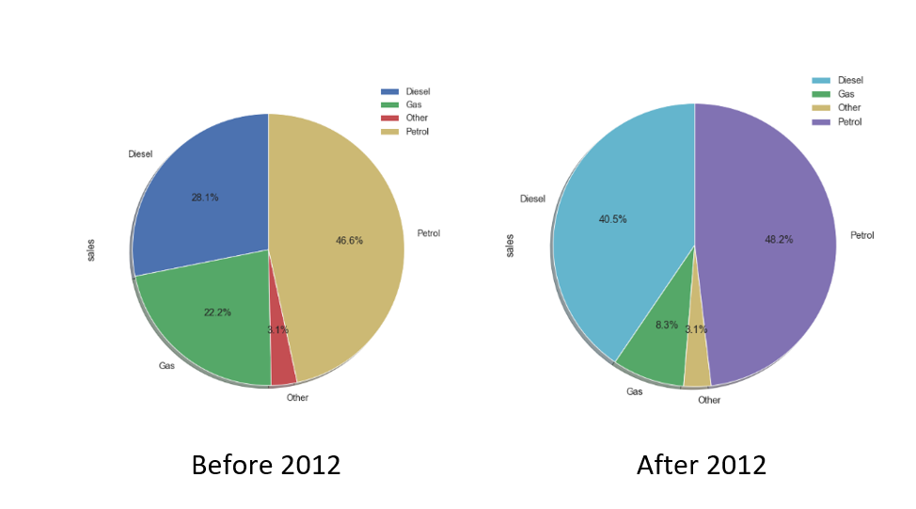
Recommendation
Most sales happening price range is between 10000 to 35000 /-
There are very few cars sold in 40000 to 60000 price bracket, which is best competitive price range
Though the cars with Gas engine type sold at most economical price, in the recent days customers are not preferred.
None of the cars sold from Economy segment in year 2016.
From the recent past the car sales are stagnated on Gas type. In other hand
Petrol car sales are consistent and incremental
Diesel car sales have gained exponential momentum
Other car sales are stagnated
Car registrations are most considered in Luxury and Premium cars
Even with affordable price range, gas and other engine type cars are least preferred.
Notes:
Observation

Slide 18
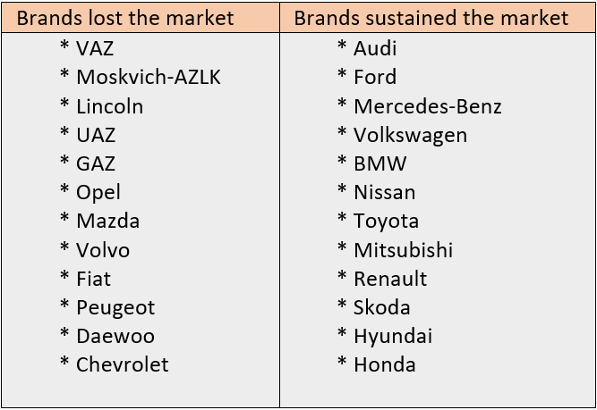
Recommendation Contd…
Most preferred
engine types are Petrol and Diesel
body types are cross-overs and sedan
Other type cars are consistent and gradually increasing in sales
Irrespective of tenure, Sedans are always on demand followed with Cross-over and hatch.
Tremendous sales reported in 2016 for these super premium cars by Bentley, Land Rover, Toyota, Tesla, Lexus, Cadillac & BMW
Recently Crossovers are leading in sales followed by sedans
Most of the recent premium cars engine type is Petrol
Cars Loose / Gain Demand

Slide 19
Insights
Cars should be available from all price ranges.
As 10000 to 35000 /- is the most sales happening price range and there are no cars available in 40000 to 60000 /- price bracket, procuring these price ranged cars should potentially improves the sales.
Pulse of the customer likelihood and market more such cars.
Petrol and Diesel cars are most popular.
Full wheel drive is most preferred in Crossovers and Front wheel drive in Sedan cars
So bring more inventory from most value for money branded cars like Mercedes-Benz, Toyota, BMW, Volkswagen etc.. Crossovers with Full wheel drive Sedans with front wheel drive
Luxury and Premium used cars booming sales due to hike in new car prices.

Slide 20
Insights Contd…
Market & Procure more latest, future ready and sophisticated cars like Engine type other (Hybrid and Electric cars). Despite the fact that car sales fluctuated across years, the Other cars sales are consistent and seen ramp up in sales recently.
Immediate tactical approach and Impressive strategic approach
Tactical Approach
Less preferred old cars should be announced with great deals and clear the stock. In that way we can save money, renting space for storage
Procure more demanded cars like Mercedes-Benz, BMW, Volkswagen, Toyota, Nissan, Ford, Audi.. etc.
Strategic Approach
Economy cars are ideally most selling. And most recent economy car are gas engines which are not preferred by customers. So procure more Economy price range cars which is of Petrol or Diesel engine types

Slide 21
Thank you

